Slide 1

SIA App Challenge Team HTTPS

Slide 2
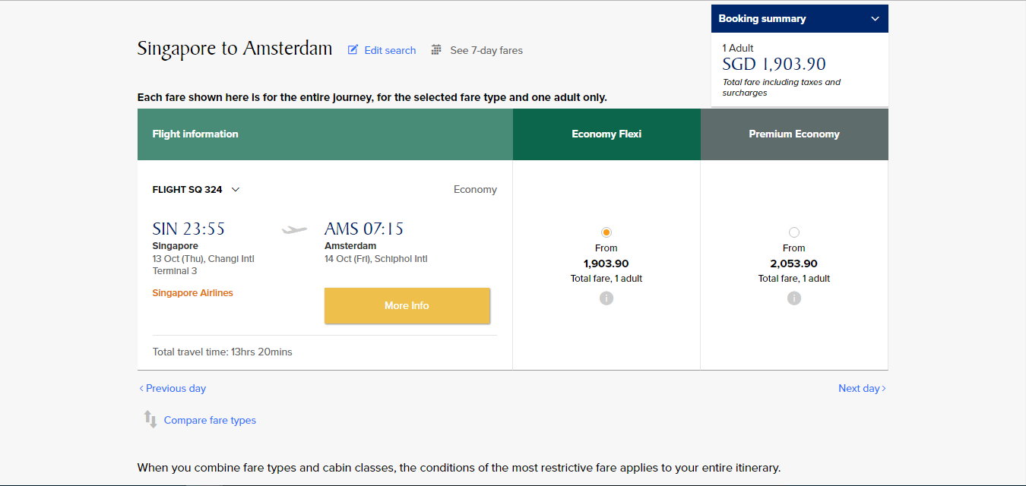

Slide 3
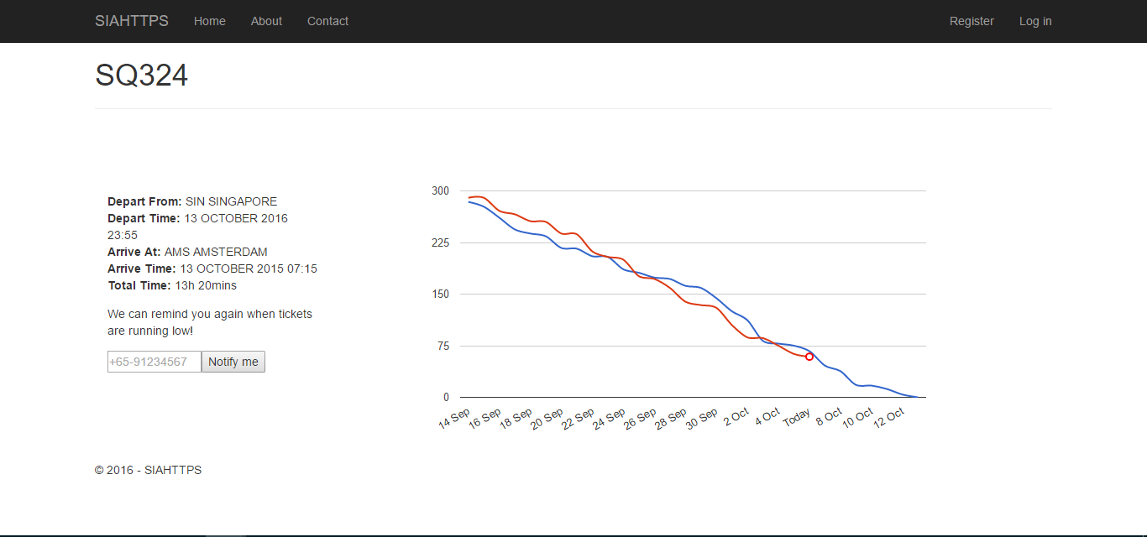
3

Slide 4

DEMO

Slide 5
$$$

